Slide 1
About the Team

Slide 2
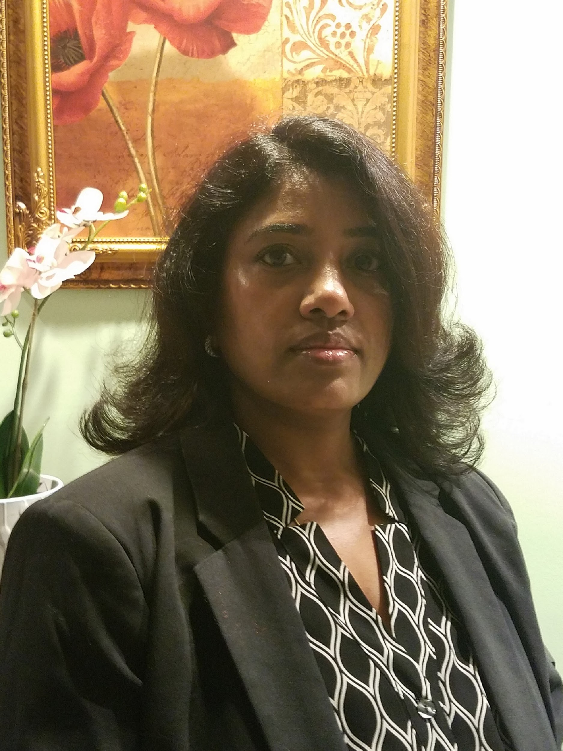
Sujatha Coovam
Instructor
Sujatha has experience in working with databases who is fascinated to embark her career in web development which laid the way to join Summitworks.
She started her career in Quality Assurance who strives to learn new things made her way to get involved in Web UI development.

Slide 3
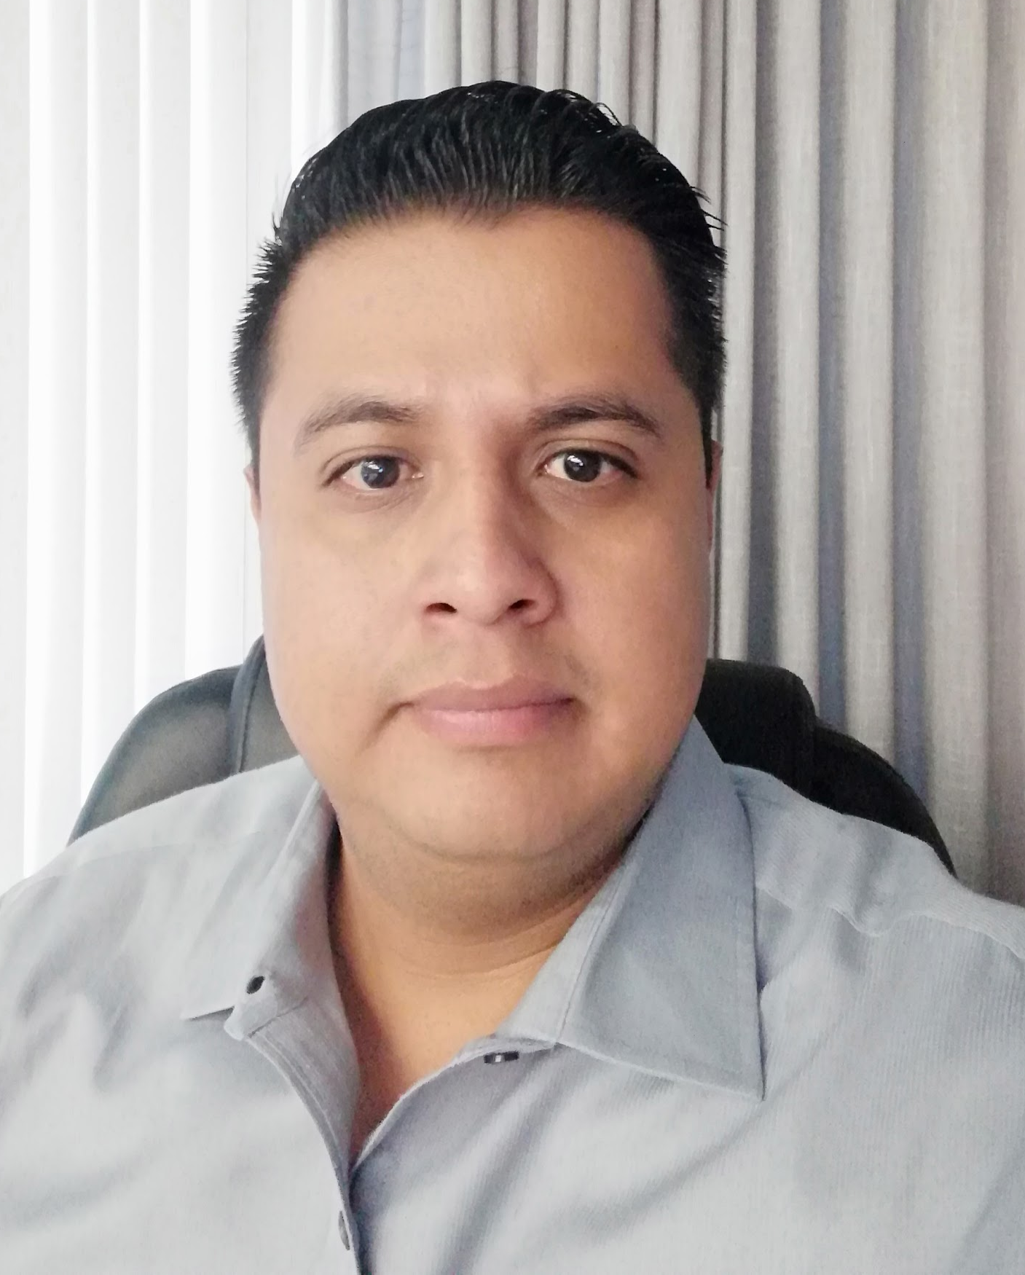
Miguel Rangel
Instructor
Miguel has a big passion for web development and design. He always love taking on new challenges and finding ways to make other individuals’ ideas succeed.
He is a Computer Science Engineer with 7 years of professional experience as a full stack developer using .Net and Azure Cloud technologies.

Slide 4
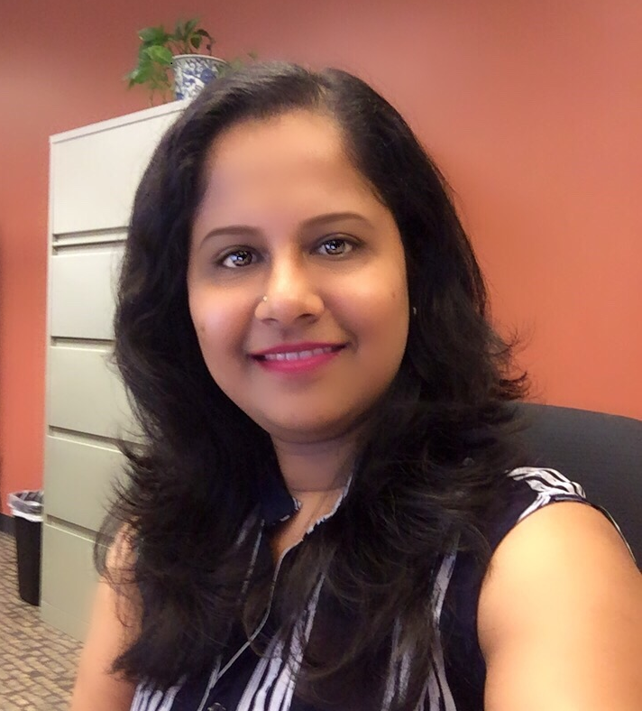
Remya Ambika
Instructor
Remya has 10 years of experience in software industries. She started her career as an SEO & Digital Marketing Specialist and switched to Front-end developer to create visually appealing applications with efficient, semantic code.
With her experience working in creative industries, her primary goal is to educate students on developing server side applications using Node and Express JS.

Slide 5
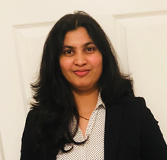
Navatha Devarapalli
Instructor
Navatha is an enthusiastic, conscientious, detail- oriented agile software programmer with 7+ years of experience in Healthcare and Financial services.
Teaching, learning and discussions on technologies is her passion.

Slide 6
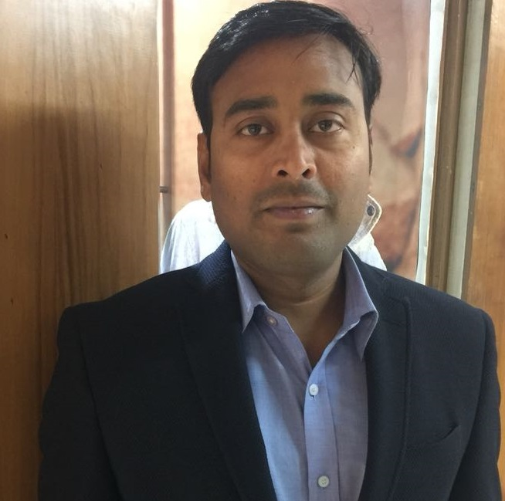
Maruthi Lingisetty
Instructor
Maruthi has 10 years of Experience in the field of Training and Development. He has a deep insight to develop computer applications using Java, J2EE, Python, Django and train the Professionals / Students in the development of latest technical software.
He is Oracle Certified Professional, Java SE 6 Programmer.

Slide 7
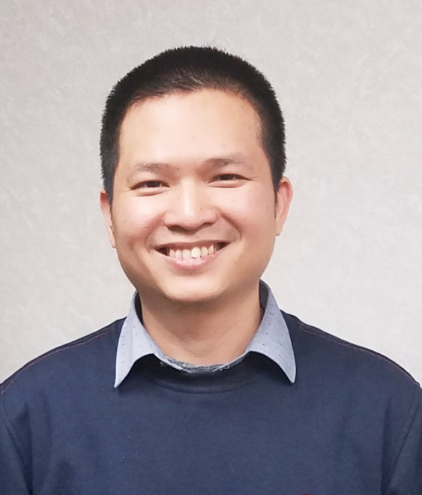
Thien Le
Instructor
Thien is a self-motivated and passionate software developer with knowledge in diverse topics in software development. With experience working in networking, telecommunication, and education, he aims to provide students with knowledge which will assist them to succeed in the future career.

Slide 8
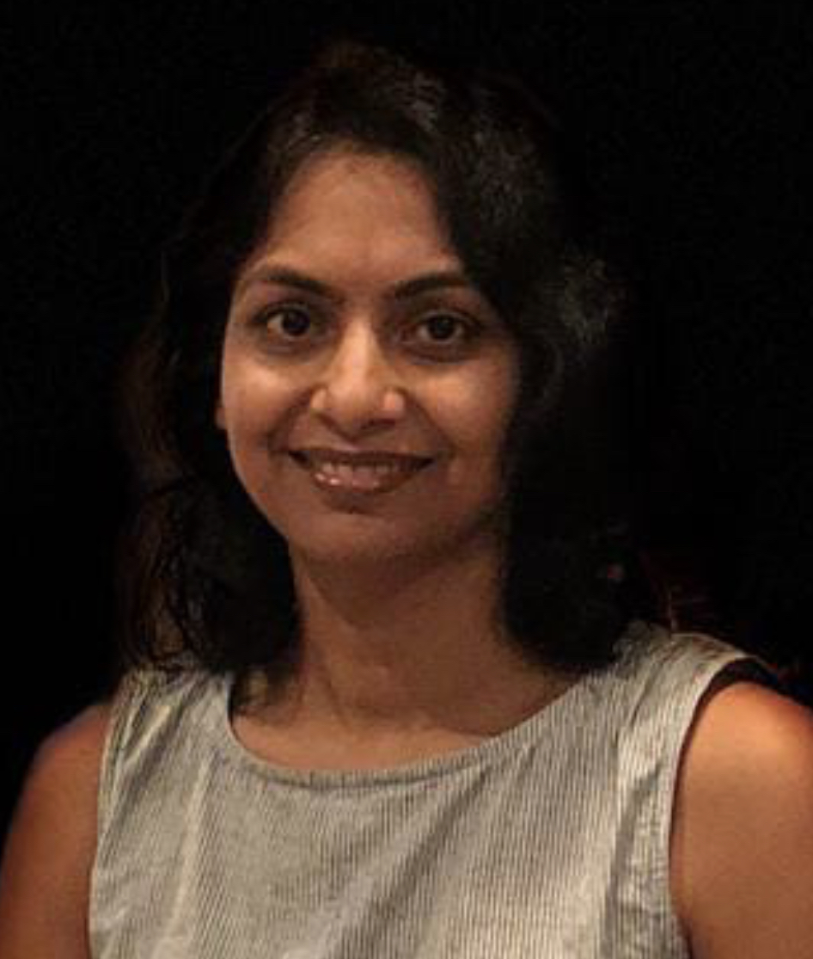
Kanchan Patil
Instructor
Kanchan has experience in the areas of Software Consultancy & Development performing System Requirement Study, Analysis, Design and Development.
She is self-motivated and passionate to learn new technologies.

Slide 9
Daily Schedule
9:30 am-11.00am | Live Sessions We'll introduce new concepts and make you implement what has been taught
11:00 am- 11:15am | Short Break Just take a coffee break.
11:15 am- 12:00 pm | Continue with the Session
12:00 pm- 1:00 pm | Lunch Break Enjoy lunch with your classmates.
1:00 pm - 2:00 pm | Exercise Enjoy programming on the scheduled exercise
2:00 pm - 4:30 pm | Live Sessions continued

Slide 10
Expected to do
Review the daily sessions
Do daily assignments and submit on time
Be active learners
Be punctual to class
Reach out to us if you have any questions

